Slide 1
摄像机操作

Slide 2
基本摄像机操作
第一人称摄像机
第三人称摄像机

Slide 3
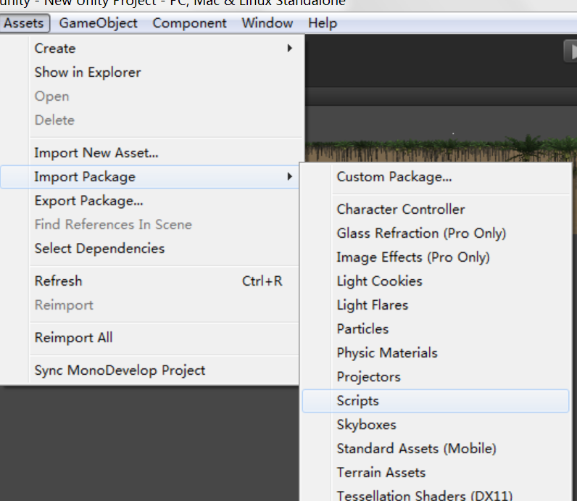
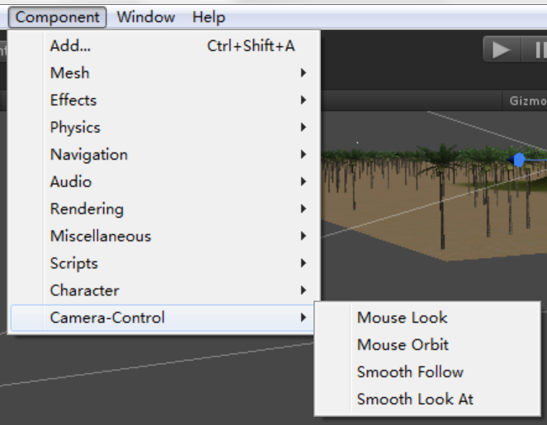
摄像机控制
Transform
Unity自带脚本

Slide 4
使用基本控制摄像机
和其他GameObject类似
位置控制
朝向控制

Slide 5
#pragma strict
var from : Transform;
var to : Transform;
var speed = 10.1;
// Time when the movement started.
private var startTime: float;
// Total distance between the markers.
private var journeyLength: float;
function Start() {
// Keep a note of the time the movement started.
startTime = Time.time;
// Calculate the journey length.
journeyLength = Vector3.Distance(from.position, to.position);
}
// Follows the target position like with a spring
function Update () {
// Distance moved = time * speed.
var distCovered = (Time.time - startTime) * speed;
// Fraction of journey completed = current distance divided by total distance.
var fracJourney = distCovered / journeyLength;
// Set our position as a fraction of the distance between the markers.
var curpos = Vector3.Lerp(from.position, to.position, fracJourney);
Debug.Log(curpos);
transform.position = curpos;
transform.rotation =
Quaternion.Slerp (from.rotation, to.rotation, fracJourney);
}

